Slide 1
Security Matters
Information Technology Services Education and Awareness Team

Slide 2
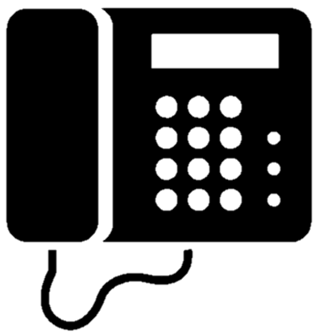
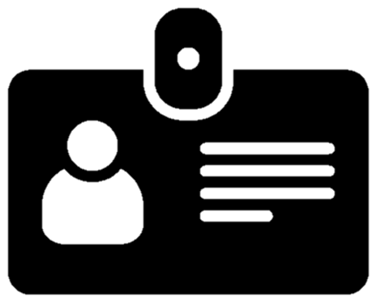
Phishing attacks can take many forms:
Common
Phishing
Spear
Phishing
Smishing
Vishing
Whaling
Fraudulent emails with a general message.
Fraudulent emails that appear to be from someone you know.
Fraudulent text messages.
Telephone calls where the caller is attempting to steal your personal information.
Phishing emails that target high profile victims (celebrities, politicians or executives).

Slide 3
Travel practices
Use precaution when connecting to Wi-Fi
Think before you connect. Connecting to a wireless network that is unsecured will expose your information and device.
Be careful when using public wireless networks or Wi-Fi hotspots; they’re not secure, so anyone could potentially see what you’re doing on your computer or mobile device while you’re connected.
Disable Wi-Fi and Bluetooth when not in use. Some stores and other locations search for devices with Wi-Fi or Bluetooth enabled to track your movements when you’re within range.

Slide 4
Safe password practices
Creating a strong password can seem like a chore. But investing the time in creating a secure password can make all the difference in protecting your personal information.
Avoid these common password no-nos:
Don’t put your username in your password.
Don’t use the same password for multiple accounts.
Don’t use one word as your password.
Don’t use repeating letters or a number sequence.
Don’t use your pet’s name.
Don’t use your personal information i.e., birthdate, address, phone number etc.
Don’t share your password or passphrase with anyone.

Slide 5
Web browsing practices
Just follow these simple secure browsing practices:
Use anti-virus and anti-spyware software.
Use different user names and passwords for different sites.
Use a firewall and install software updates.
Trust HTTPs: Look for the “s” or a padlock symbol that indicates that a website is secure.
Avoid free Wi-Fi.
These days, users have the world at their finger-tips while browsing online. Unfortunately, with all this freedom users can unwittingly fall victim to hacking or phishing attacks.

